Slide 1

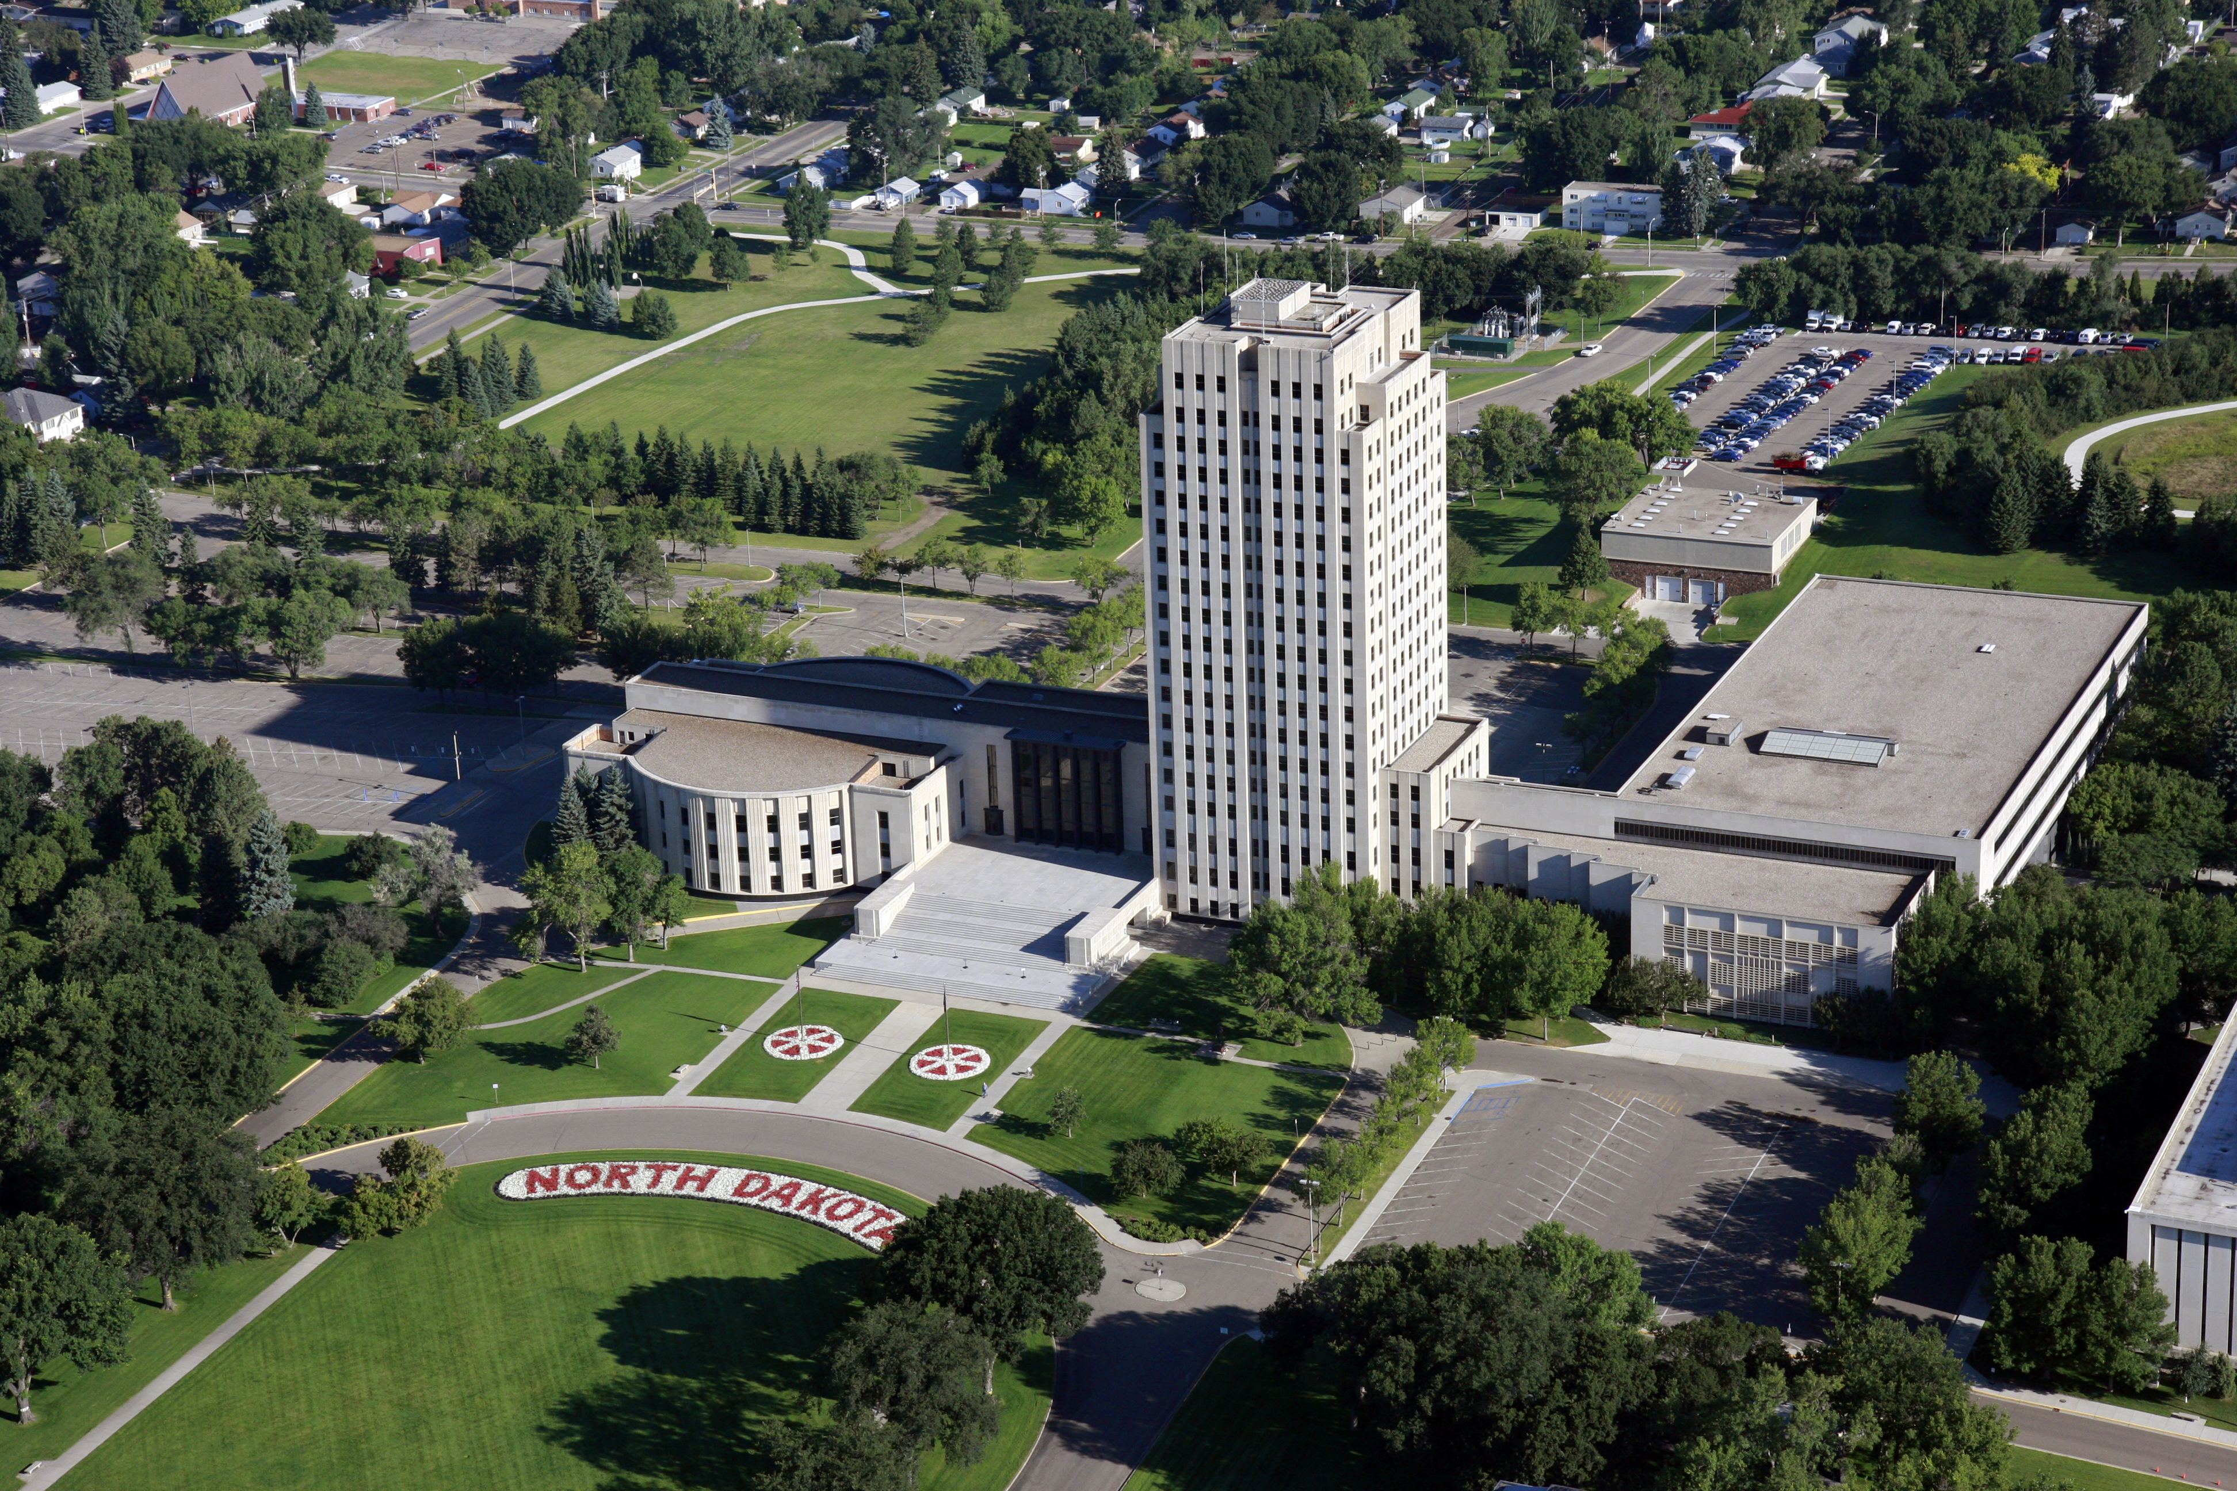
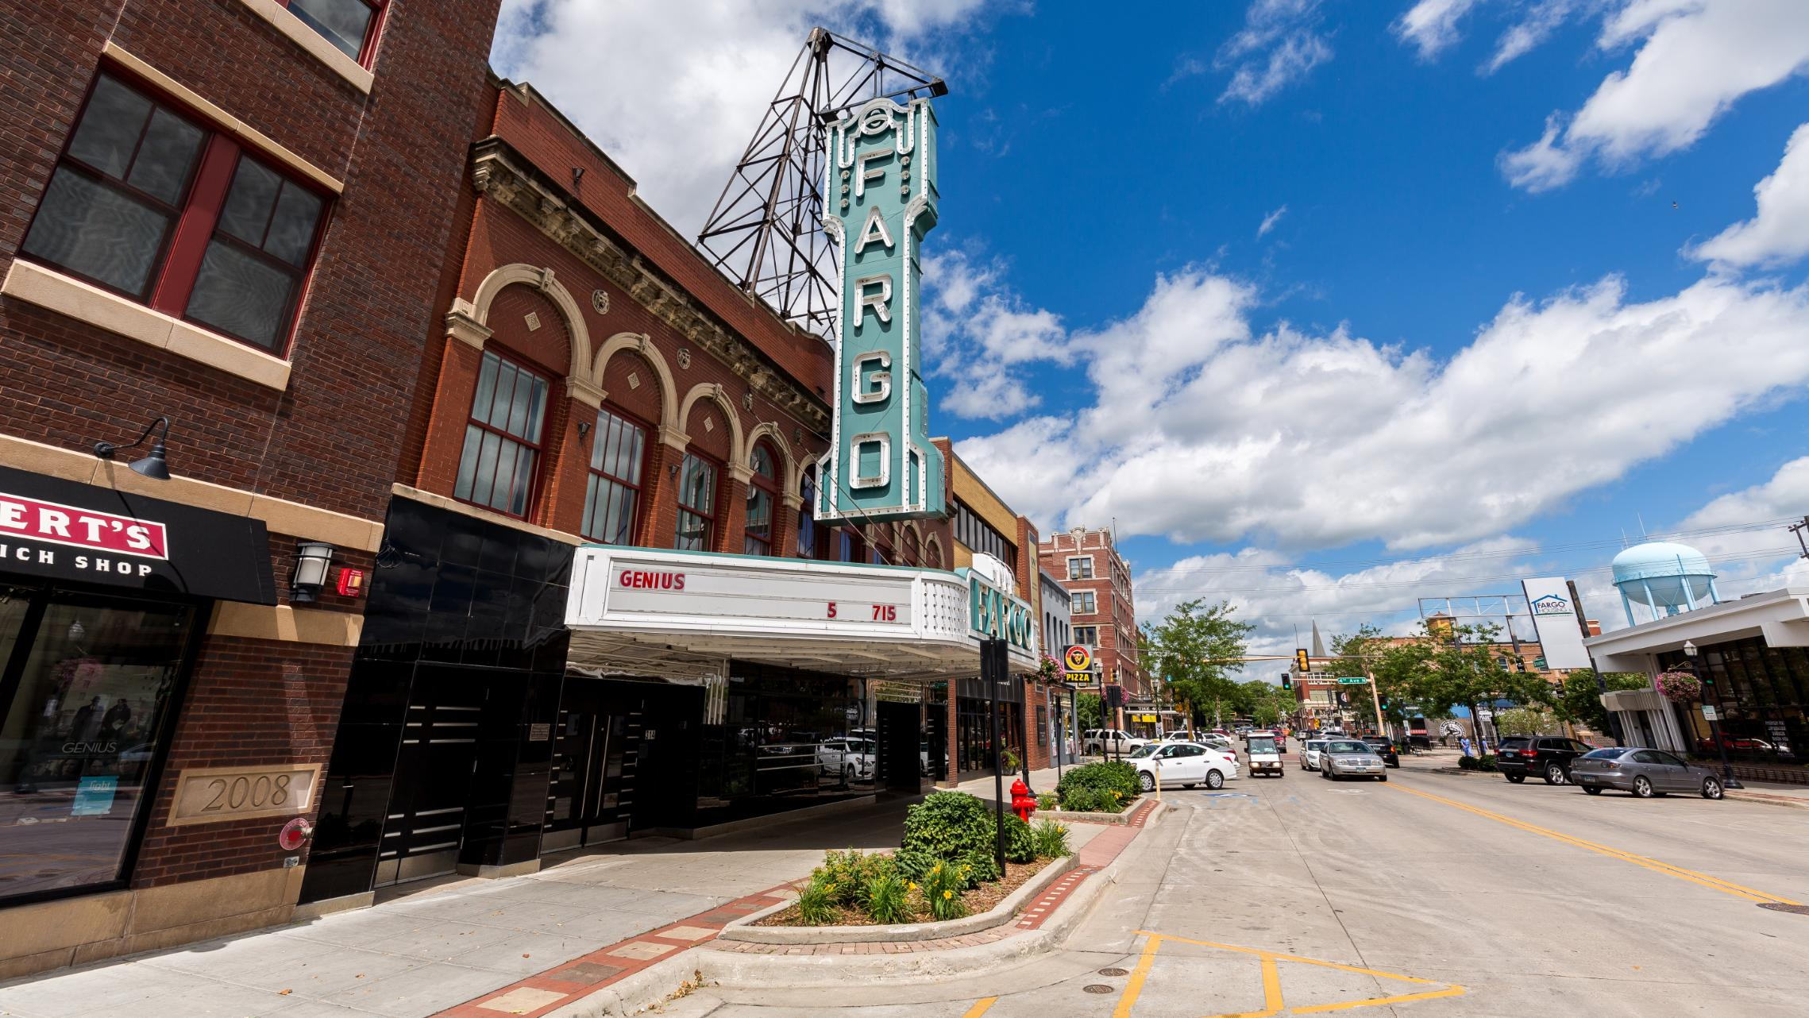

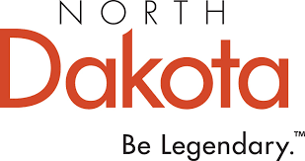
North Dakota National Awareness and Perception Study
September 28, 2022

Slide 2
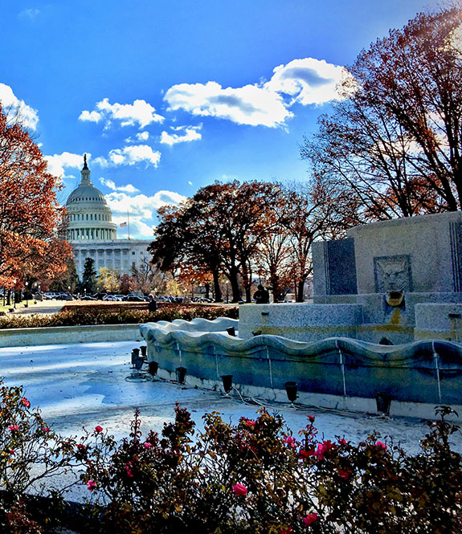
Agenda
Background and Methodology
National Talent Trends
Perceptions of North Dakota
Key Findings and Recommendations
Q & A

Slide 3
Background and Methodology

Slide 4
Consumer Perception Study Overview
To establish baseline metrics and perceptions of North Dakota among working age individuals.
Background and Methodology
Methodology
An online survey developed in cooperation with the North Dakota Department of Commerce. Surveys were distributed via email to individuals over 21 years of age with at least a high school diploma who do not currently live in North Dakota. Quotas ensured sample was balanced to represent the U.S.
Respondents
1,002 working age individuals
    - 300 from the South
    - 252 from the West
    - 243 from the Northeast
    - 207 from the Midwest (not including North Dakota)

Slide 5
National Trends

Slide 6
National Talent Trends
DCI’s Talent Wars research shows an emerging trend in the talent attraction landscape: talent is prioritizing an improved quality of life, now more than ever.
Moving closer to family is a top-trigger inspiring relocation (emphasizing the importance of a boomerang strategy).
This year’s study revealed the top three ways talent forms impressions of an area include internet research, first-hand experience and word of mouth.
Talent largely relocates in the same region as their original residence…but not always.
Promote regional and statewide assets to appeal to the widest audience.

Slide 7



Top Triggers Inspiring Relocation
46%
For a better quality of life
31%
To be closer
to family
27%
Wanting a different lifestyle
Source: DCI’s Talent Wars, 2022

Slide 8
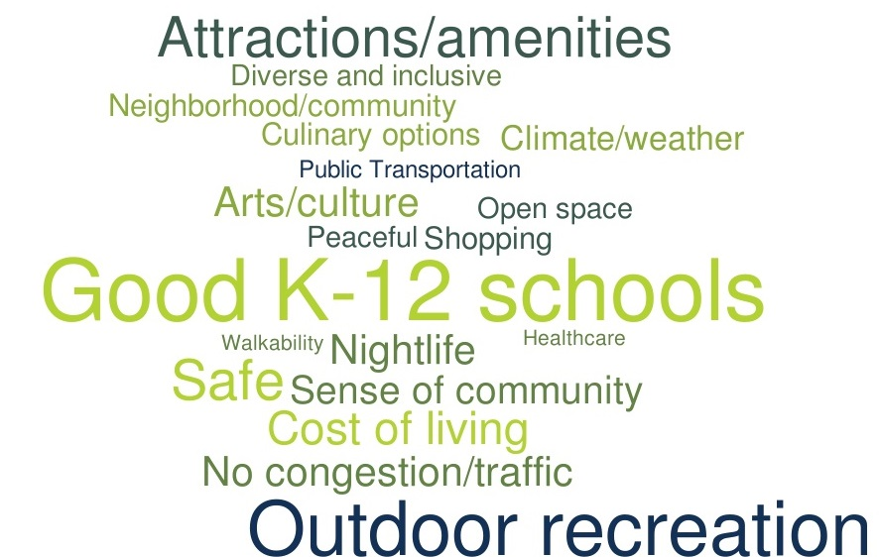

Source: DCI’s Talent Wars, 2022

Slide 9
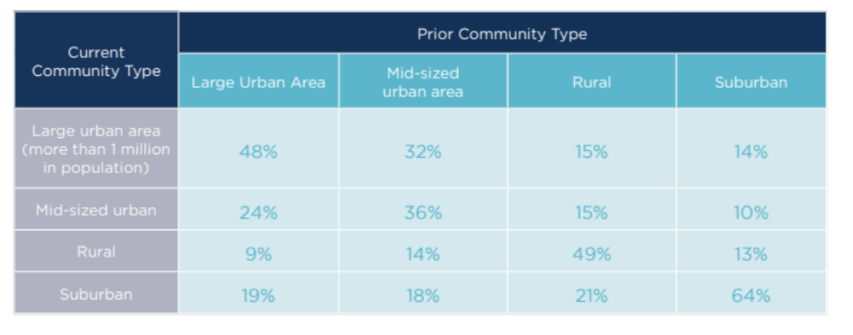
Where Talent Wants to Live…
Source: DCI’s Talent Wars, 2022

Slide 10
Importance of Lifestyle-Related Factors*
* Based on DCI’s customized research for North Dakota

Slide 11
Importance of Career-Related Factors*
* Based on DCI’s customized research for North Dakota

Slide 12
Perceptions of North Dakota

Slide 13
Perceptions of North Dakota

Slide 14
Level of Familiarity with North Dakota
…have lived in or visited ND

Slide 15
Perceptions of North Dakota, by Familiarity

Slide 16
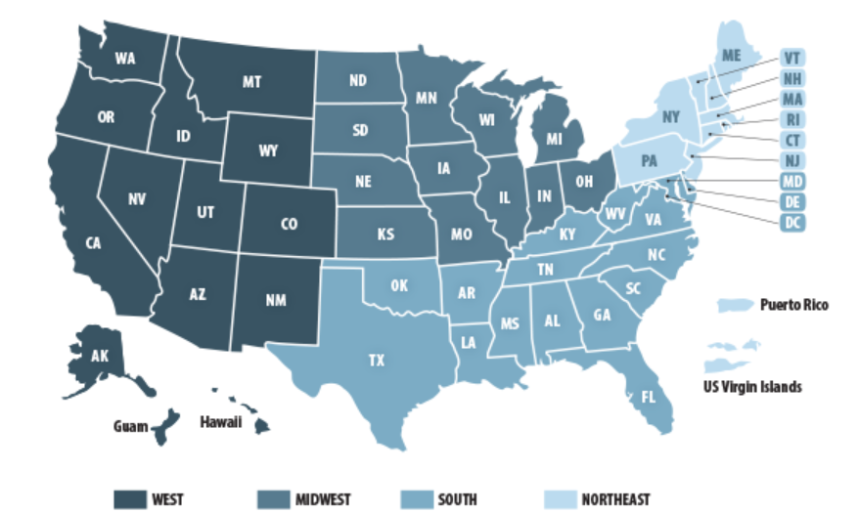
Regions of the U.S.

Slide 17
Perceptions of North Dakota by Region

Slide 18
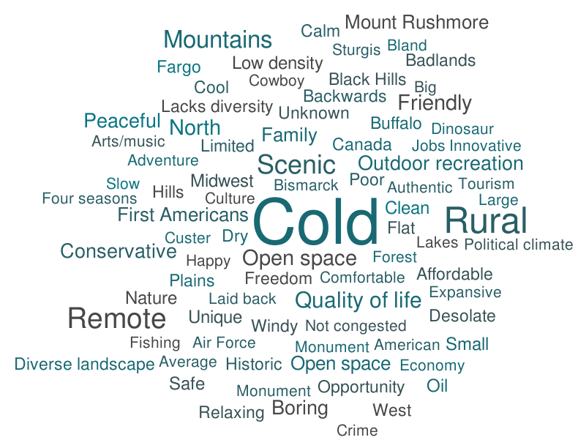
Top Associations with North Dakota

Slide 19
The “Feel” of North Dakota

Slide 20
Industries Associated with North Dakota

Slide 21
Interest in Relocating to North Dakota
24% of respondents report they would not be willing to relocate to North Dakota because of the climate.​
​
Other top reasons preventing relocation:
Too far from family/friends​
Unknown​
Q. If a job opportunity that matched your skill and salary requirements were offered to you in North Dakota, would you be willing to relocate?

Slide 22

Profile of Talent Interested in Relocating to North Dakota
71%
…are familiar with
North Dakota.
79% are employed full or part time
55% live with a spouse/partner or a spouse/partner and children
50% are between the ages of 30 and 49
36% have a Bachelor’s degree or higher

Slide 23
Most Useful Tools When Considering Relocation

Slide 24
How Impressions of North Dakota were Informed

Slide 25




Social Media Channels to Expand Your Influence
Employment
Opportunities
59%
41%
36%
Relocation
57%
45%
41%
Travel
56%
51%
45%
Source: DCI’s Talent Wars, 2022

Slide 26
Key Findings

Slide 27
Key Findings
Perceptions of the state are moderate but largely driven by a lack of familiarity.
The depth/breadth of industry sectors and career opportunities in North Dakota are largely unknown among talent. The state is perceived more favorably as a place to visit and live.
Talent is reprioritizing the importance of lifestyle-related factors and North Dakota is well-positioned to capitalize on its quality of life.
First-hand experience is critical in influencing perceptions of an area and North Dakota has a significant opportunity to appeal to visitors in-destination who are there to experience the state’s outdoor recreation, historical and cultural assets. While in-destination, messaging on lifestyle and career-related assets is encouraged to reach this target audience.
Messaging should be tailored to platforms most utilized by talent but does not have to be customized by region.

Slide 28
Key Findings
The talent most interested in relocating to the state are more “settled” and established in their career and family-life.
Messaging and marketing needs to leverage perceived strengths and counteract misperceptions.
  Embrace the cold. Consider messaging as a “climate haven”
  Arming employers with information to sell state/regions to prospective employees will be important.
  Affordability particularly relative to salaries (don’t market as a “cheap” location but rather “value-driven”.
  Depth/breadth of industry sectors and job opportunities
  Housing cost/availability; safety/security; attractions and amenities
  Diversity of living environments regionally (i.e., rural, suburban, downtown)
Key messages should be internally as well as externally communicated.

Slide 29
Thank You!

