Slide 1
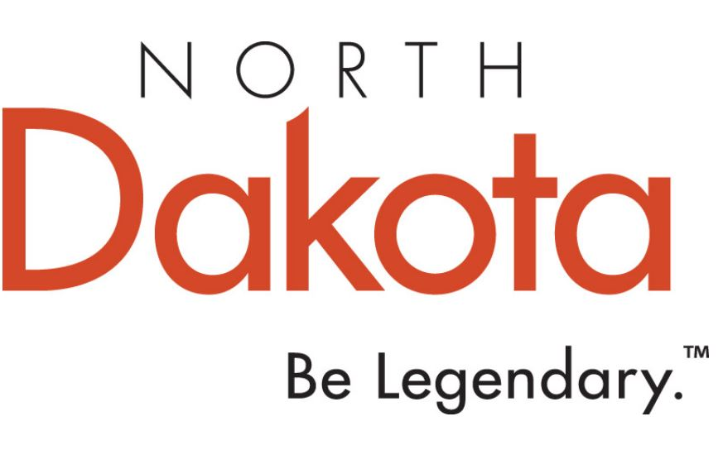
North Dakota
2021
Advertising ROI Research

Slide 2
Table of Contents
Background and Purpose……………………………………………………………………………………………………………………………………….…………. 3
Method…………………………………………….…………………………………………………………………………….…………………………………................ 4
Conclusions and Recommendations……….……………………………….…………………………………………………………………..…..………………. 6
Main Findings: Advertising Impacts……………………………………………………………………………………………….…………………..…………….. 10
  Advertising Awareness……………………………………………………………………………………………………………..……..…………………….. 11
  Media Diagnostics…….………………………………………..……………………………………………………….……………………….................... 38
  Short-Term Conversion……..………………………………………………………………………………………………………….………….…….......... 43
  Destination Visitation and Intent to Visit………………………………………………………………………….…………………………..…………. 49
Hesitations about Traveling to North Dakota………………………………………….………………………………………………………….…………….. 53

Slide 3
Background and Purpose
North Dakota Tourism’s 2021 advertising campaigns were launched in key markets.
  The campaign consisted of both traditional and online media including:
    Broadcast television and radio
    Digital (e.g., banner advertisements, streaming video/audio)
    Social media
    Out-of-home
    Print
    Sponsorship
Longwoods was engaged to conduct a program of research designed to:
  Measure the ROI and advertising awareness of North Dakota Tourism’s 2021 advertising campaign.
3

Slide 4
Method
A benchmark study was conducted after the conclusion of the advertising period to measure awareness of specific ads and measure short-term conversion that occurred during and shortly after the campaign period.
  A self-completion survey of 1,403 respondents in key markets, distributed as follows:
      Illinois 300
      Minnesota 250
      Wisconsin 252
      North Dakota 100
      South Dakota 100
      Denver DMA 201
      Manitoba 100
      Saskatchewan 100
  To qualify for the survey, respondents must have personally taken at least one day or overnight leisure trip in the past three years and intend to take at least one day or overnight leisure trip in the next two years.
4

Slide 5
Method (Cont’d)
Respondents are members of a major online consumer research panel. Adults 18 years of age and older were randomly selected from the panel, so as to ensure a representative sample.
Sample was drawn to be proportionate to population by specific states, age, and sex.
During the survey respondents were shown copies of the advertising materials, including video files of media-rich ads. This was done at the end of the survey as not to bias earlier questions on attitudes towards North Dakota and other behavioral measures.
The fieldwork was conducted in May 2022.
Mean length of survey was 13 minutes.
Data were weighted on key demographic variables (geography, age, sex, household income, household size) prior to analysis to ensure that results are representative of and projectable to the traveler population in specific markets.
For a sample of this size, the confidence level is +/- 3%.
The estimates of the campaign’s impacts on visits to visit North Dakota are conservative in that:
  Trips taken/intended by people in the absence of advertising are backed out.
  Conservative control procedures help ensure that only advertising-influenced trips are included.
5

Slide 6
Conclusions and Recommendations

Slide 7
Conclusions and Recommendations
Over half of travelers in North Dakota’s regional advertising markets recalled seeing at least one North Dakota Tourism Division ad.
Ad awareness was fairly even among the markets included in the survey, with the highest levels of awareness among travelers in North Dakota, Canada (the provinces of Manitoba and Saskatchewan), Wisconsin, and Illinois. The only market where less than half of the travelers were aware of at least one North Dakota ad was South Dakota.
Travelers were more likely to remember at least one digital ad, followed by sponsorship, broadcast radio, and print ads. The lowest levels of recall occurred with broadcast television, out-of-home (OOH), and social media ads.
For the markets included in this study, there were an estimated 275 million ad exposures over the campaign period.
The average frequency of recall by medium follows a similar, but not exact, pattern as awareness levels. Digital ads (128 million exposures) showed the highest frequency of recall, followed by sponsorship (43 million exposures), broadcast radio (28 million exposures), broadcast television (24 million exposures), and print (23 million exposures) ads. OOH (17 million exposures) and social media (13 million exposures) have the lowest frequency of recall.
7

Slide 8
Conclusions and Recommendations (Cont’d)
When we relate the number of ad exposures recalled to the specific amount of money spent on the ads by medium, broadcast radio ads constituted the most efficient medium in terms of generating recall per dollar spent, at less than $1 per thousand of exposures recalled, followed by social media ads at $4 per thousand of exposures recalled and sponsorship ads at $9 per thousand of exposures recalled. Broadcast television was the least efficient at generating recall ($107 per thousand exposures recalled). However, given the cost of advertising in this medium, this is both expected and within the normal range for this category.
The average cost per thousand exposures recalled was $26.
The campaign produced an additional 1.4 million trips to North Dakota that otherwise would not have materialized in the absence of advertising. Longwoods estimates that these incremental North Dakota visitors spent $241.9 million while in North Dakota.
When related to advertising costs of $7.2 million, this translates into a return on investment of $34 in visitor spending for each ad dollar spent.
8

Slide 9
Conclusions and Recommendations (Cont’d)
Those incremental expenditures yielded $23.5 million in state and local taxes and a return on investment of $3 in taxes for each ad dollar spent.
The North Dakota Tourism Division spent an average of $5.26 in advertising for every incremental trip earned from this campaign.
Longwoods cautions North Dakota Tourism Division against comparing this ROI result with past years before the COVID-19 crisis. The large amount of grant money awarded to North Dakota’s competitors and the amount of increased competition North Dakota faces throughout its feeder markets from destinations using their grant money in new markets made visitation conversion more expensive in 2021. Adding to this was lingering travel hesitation in some American traveler segments and the Canadian border being closed to leisure travel until August 2021 also helped make that year an atypical year.
Less than half of travelers in North Dakota’s regional advertising markets have visited the state in their lifetimes, with a quarter visiting during the past 2 years. A third intend on visiting North Dakota during the next 12 months.
9

Slide 10
Main Findings:
Advertising Impacts

Slide 11
Advertising Awareness

Slide 12
Advertising Awareness
Over half (56%) of travelers in North Dakota’s regional advertising markets recalled seeing at least one North Dakota Tourism Division ad.
Ad awareness was fairly even among the markets included in the survey, with the highest levels of awareness among travelers in North Dakota (65%), Canada (the provinces of Manitoba and Saskatchewan, 58%), Wisconsin (58%), and Illinois (57%). The only market where less than half of the travelers were aware of at least one North Dakota ad was South Dakota (43%).
Travelers were more likely to remember at least one digital ad (51%), followed by sponsorship (35%), broadcast radio (32%) and print (30%) ads. The lowest levels of recall occurred with broadcast television (24%), out-of-home (OOH, 22%), and social media (21%) ads.
12

Slide 13
Advertising Awareness (Cont’d)
The ads with the highest level of recall were:
  ND Print Compilation 4 (38%)
  ND Print Compilation 1 (35%)
  CA 30s Broadcast Radio (32%)
  Digital TRNP 2 (31%)
  CA Digital SK (30%)
  CA 30s Facebook (30%)
  Denver 15s Family Fun Audio (30%)
  ND Digital Summer (30%)
Please note that the base of each of these percentages for individual ads is the markets where the ads were shown, and not necessarily all markets.
13

Slide 14
Awareness of the Ad Campaign
Base: Residents of North Dakota’s Regional Advertising Markets
*Saw at least one ad

Slide 15
Awareness* by Market
Base: Residents of North Dakota’s Regional Advertising Markets
15
*Canada includes Manitoba and Saskatchewan
**Caution: Weighted base <50

Slide 16
Advertising Awareness* by Medium
Base: Residents of North Dakota’s Regional Advertising Markets
*Saw at least one ad and based on markets where shown

Slide 17

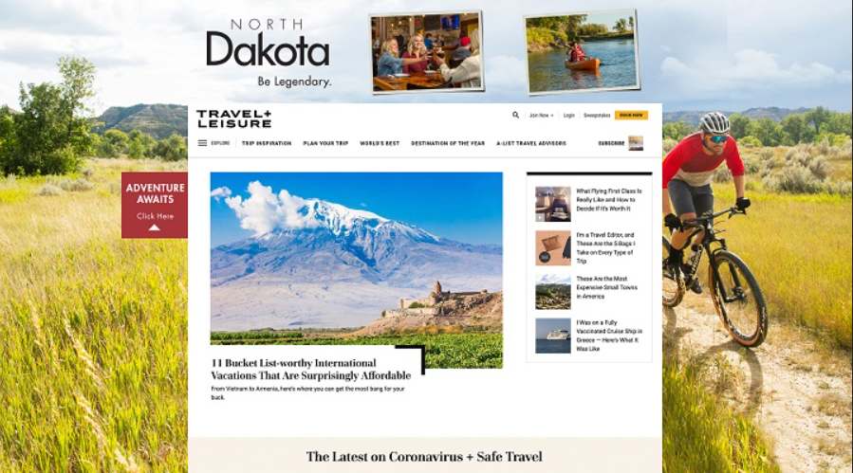
Digital Creative
Cybba Skin Digital
Cybba Onsite Digital

Slide 18
Awareness of Individual Ads* - Digital
Base: Residents of North Dakota’s Regional Advertising Markets
*Based on markets where shown

Slide 19
Awareness of Individual Ads* - Digital (Cont’d)
Base: Residents of North Dakota’s Regional Advertising Markets
*Based on markets where shown

Slide 20
Awareness of Individual Ads* - Digital (Cont’d)
Base: Residents of North Dakota’s Regional Advertising Markets
*Based on markets where shown

Slide 21
Awareness of Individual Ads* - Digital (Cont’d)
Base: Residents of North Dakota’s Regional Advertising Markets
*Based on markets where shown

Slide 22
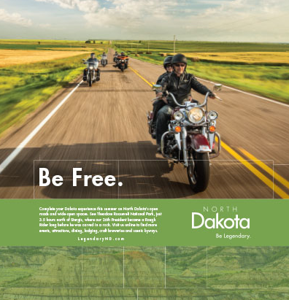

Sponsorship Creative
Buffalo Chip Print
Packers Digital Compilation

Slide 23
Awareness of Individual Ads* - Sponsorship
Base: Residents of North Dakota’s Regional Advertising Markets
*Based on markets where shown

Slide 24
Awareness of Individual Ads* - Broadcast Radio
Base: Residents of North Dakota’s Regional Advertising Markets
*Based on markets where shown

Slide 25
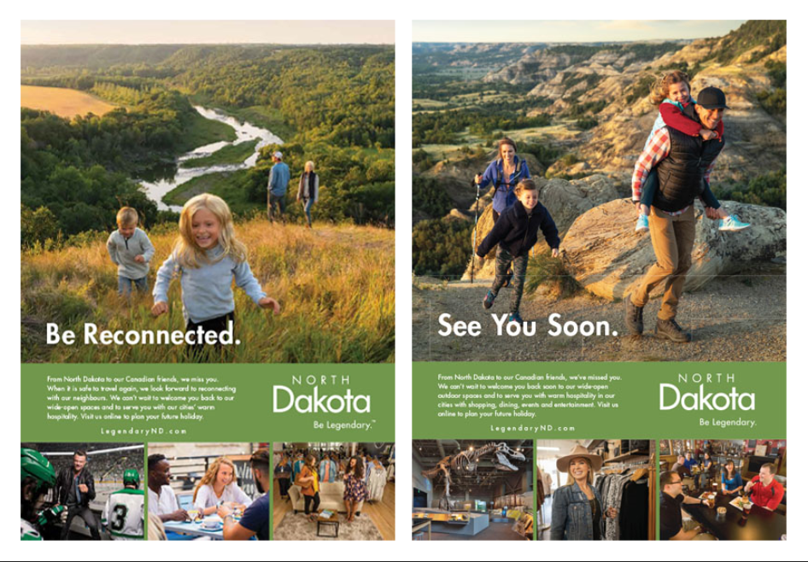
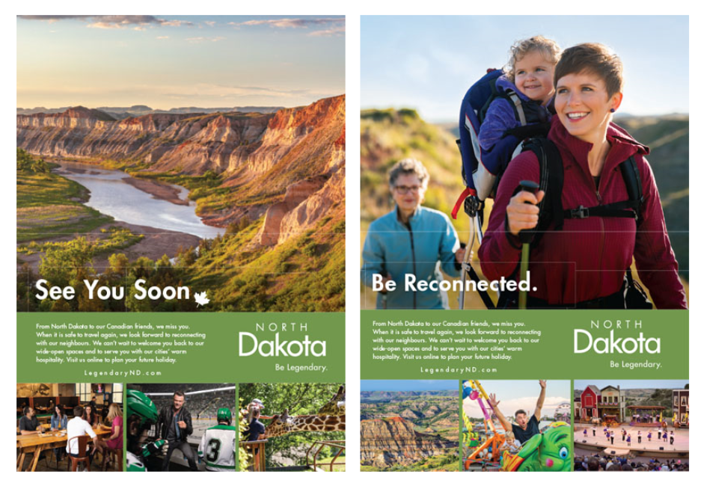
Print Creative
CA Print Compilation 1
CA Print Compilation 2

Slide 26

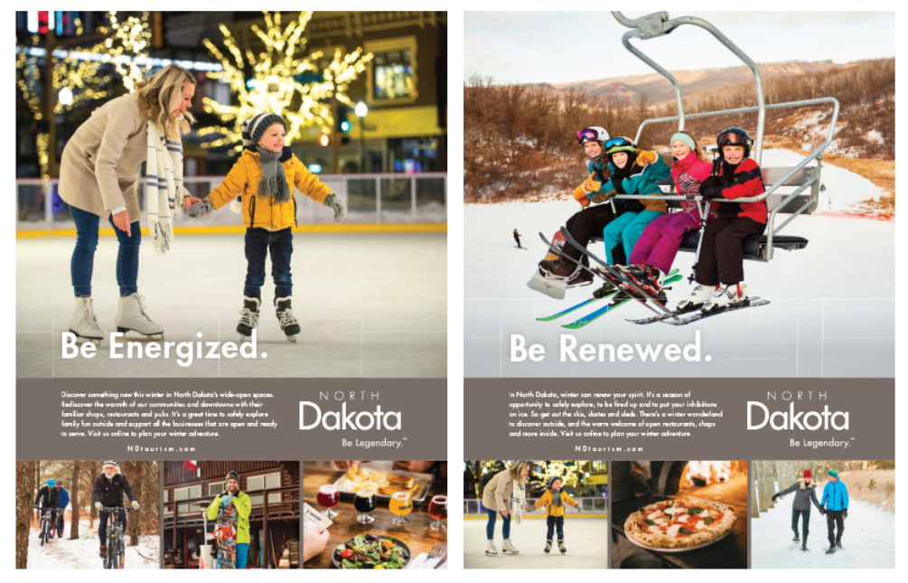
Print Creative (Cont’d)
ND Print Compilation 1
ND Print Compilation 2

Slide 27

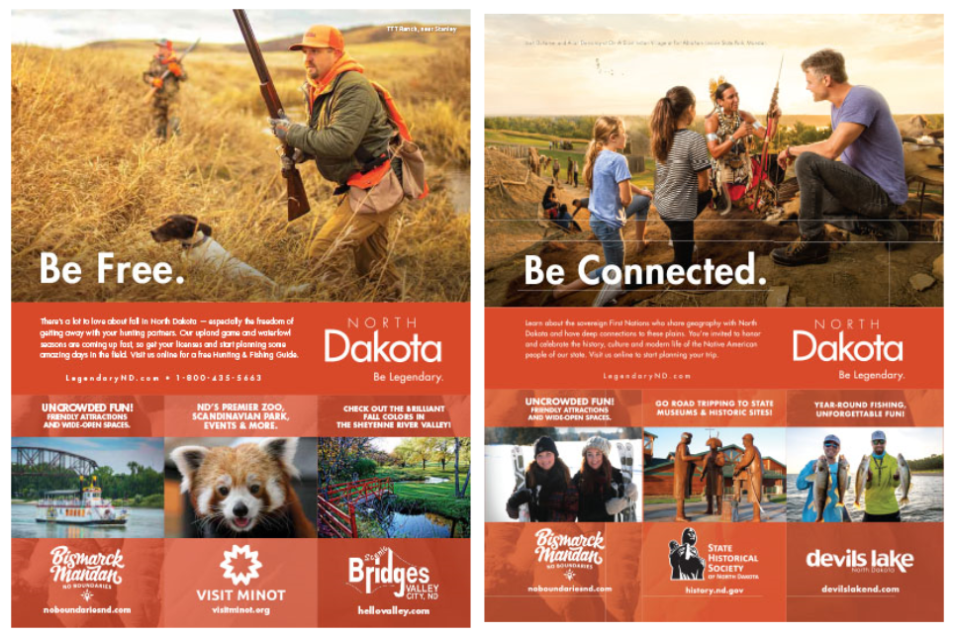
Print Creative (Cont’d)
ND Print Compilation 3
ND Print Compilation 4

Slide 28


Print Creative (Cont’d)
ND Print Compilation 5
Primary US Print Compilation 1

Slide 29
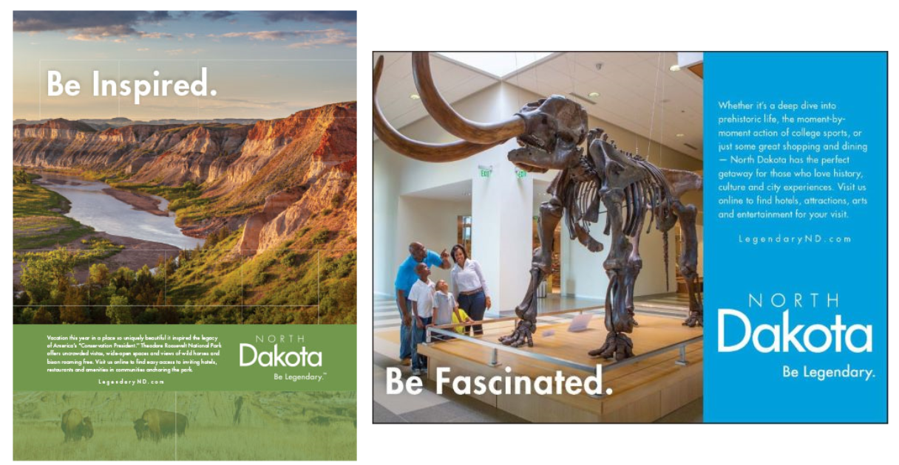
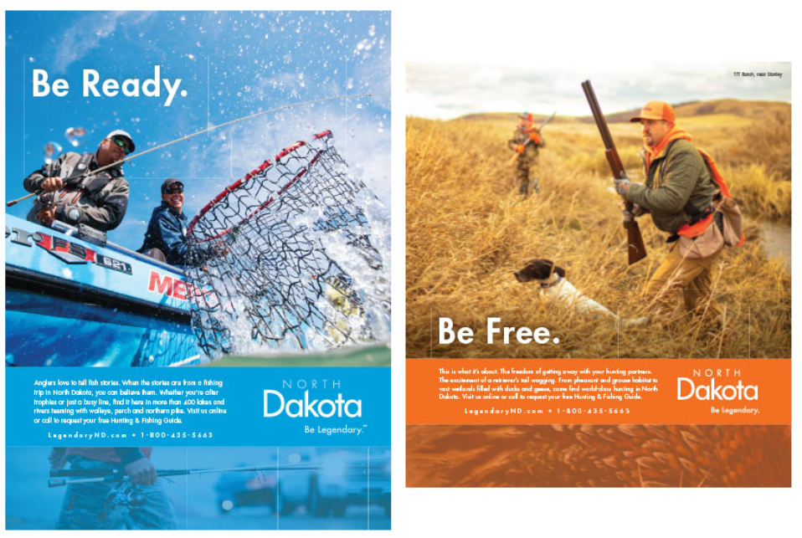
Print Creative (Cont’d)
Primary US Print Compilation 2
Primary US Print Compilation 3

Slide 30

Print Creative (Cont’d)
Primary US Print Compilation 4

Slide 31
Awareness of Individual Ads* - Print
Base: Residents of North Dakota’s Regional Advertising Markets
*Based on markets where shown

Slide 32
Awareness of Individual Ads* - Broadcast TV
Base: Residents of North Dakota’s Regional Advertising Markets
*Based on markets where shown

Slide 33
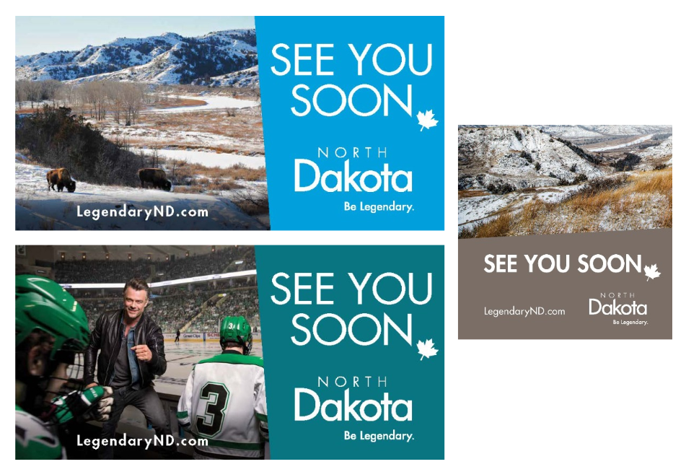
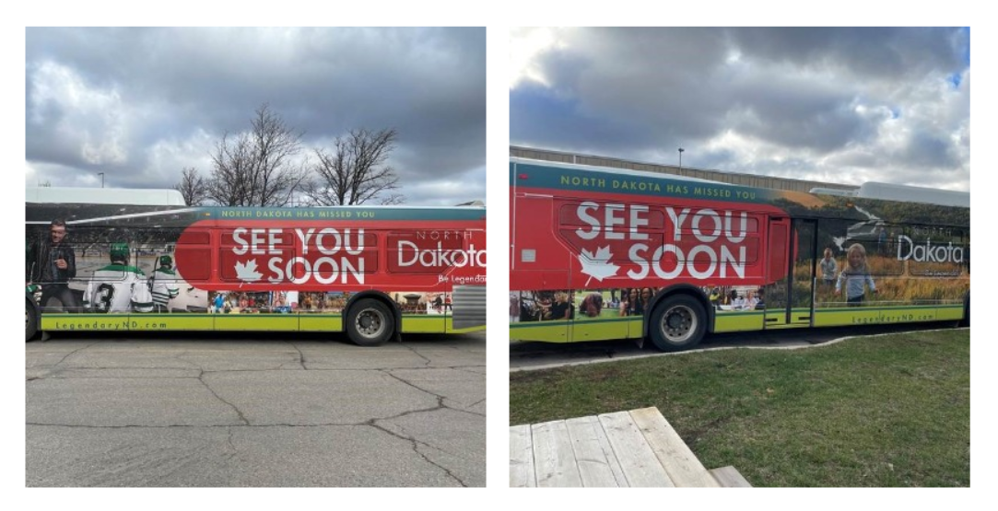
Out-of-Home Creative
CA OOH Compilation 1
CA OOH Compilation 2

Slide 34
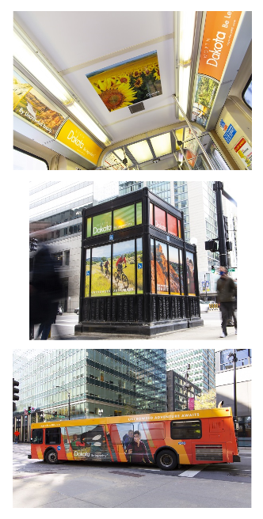
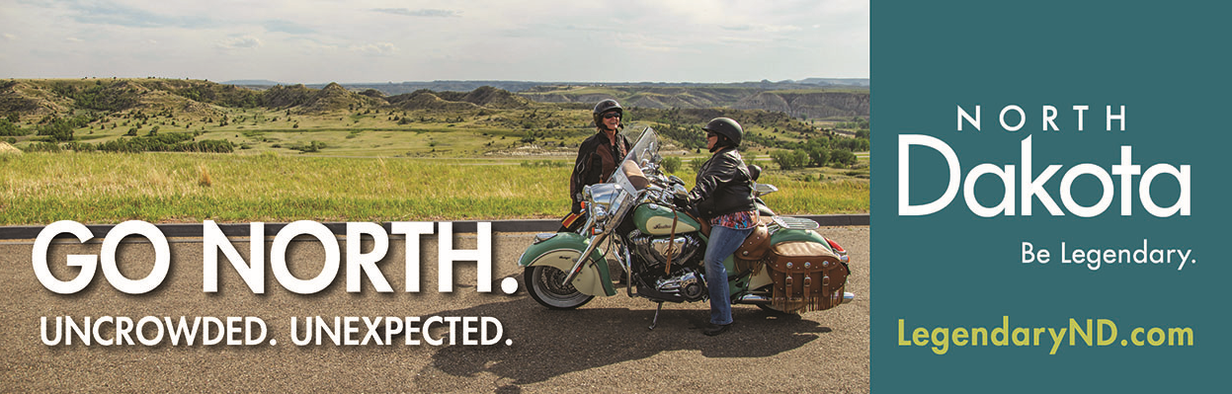
Out-of-Home Creative (Cont’d)
SD OOH Billboard
IL OOH Bus Compilation

Slide 35
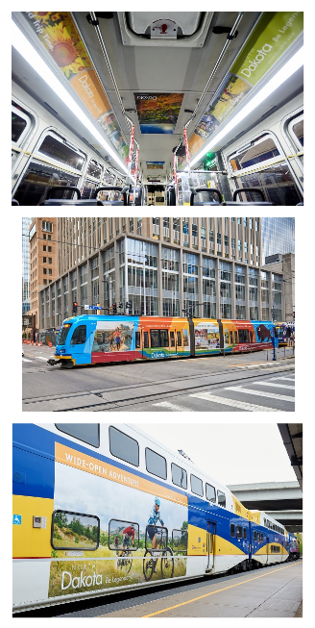

Out-of-Home Creative (Cont’d)
IL OOH Compilation
MN OOH Compilation

Slide 36
Awareness of Individual Ads* - Out-of-Home
Base: Residents of North Dakota’s Regional Advertising Markets
*Based on markets where shown

Slide 37
Awareness of Individual Ads* - Social Media
Base: Residents of North Dakota’s Regional Advertising Markets
*Based on markets where shown

Slide 38
Media
Diagnostics

Slide 39
Advertising Awareness
For the markets included in this study, there were an estimated 275 million ad exposures over the campaign period.
The average frequency of recall by medium follows a similar, but not exact, pattern as awareness levels. Digital ads (128 million exposures) showed the highest frequency of recall, followed by sponsorship (43 million exposures), broadcast radio (28 million exposures), broadcast television (24 million exposures), and print (23 million exposures) ads. OOH (17 million exposures) and social media (13 million exposures) have the lowest frequency of recall.
39

Slide 40
Advertising Awareness (Cont’d)
When we relate the number of ad exposures recalled to the specific amount of money spent on the ads by medium, we see that:
  Broadcast radio ads constituted the most efficient medium in terms of generating recall per dollar spent, at less than $1 per thousand of exposures recalled, followed by social media ads at $4 per thousand of exposures recalled and sponsorship ads at $9 per thousand of exposures recalled.
  Digital ads had a $20 per thousand of exposures recalled, while print ads generated a $31 per thousand of exposures recalled and OOH ads $55 per thousand of exposures recalled.
  Broadcast television was the least efficient at generating recall ($107 per thousand exposures recalled). However, given the cost of advertising in this medium, this is both expected and within the normal range for this category.
The average cost per thousand exposures recalled was $26.
40

Slide 41
Total Exposures Recalled by Medium
Total Exposures = 275 Million
*Incidence of awareness x population aware x mean frequency recalled

Slide 42
Cost per Thousand Exposures Recalled by Medium
Total Exposures = 275 Million
Digital | $2,525,136
Broadcast TV | $2,520,503
Out-of-Home | $953,119
Print | $690,012
Sponsorship | $389,384
Social Media | $54,244
Broadcast Radio | $37,969
Total Ad Spend | $7,170,366

Slide 43
Short-Term
Conversion

Slide 44
Short-Term Conversion
The campaign produced an additional 1.4 million trips to North Dakota that otherwise would not have materialized in the absence of advertising.
Using Travel USA® estimates of average visitor expenditures, we estimate that these incremental North Dakota visitors spent $241.9 million while in North Dakota.
When related to advertising costs of $7.2 million, this translates into a return on investment of $34 in visitor spending for each ad dollar spent.
Those incremental expenditures yielded the following in taxes:
  $23.5 million in state and local taxes.
  Return on investment of $3 in taxes for each ad dollar spent.
The North Dakota Tourism Division spent an average of $5.26 in advertising for every incremental trip earned from this campaign.
44

Slide 45
Short-Term Conversion (Cont’d)
Longwoods cautions North Dakota Tourism Division against comparing this ROI result with past years before the COVID-19 crisis. The large amount of grant money awarded to North Dakota’s competitors and the amount of increased competition North Dakota faces throughout its feeder markets from destinations using their grant money in new markets made visitation conversion more expensive in 2021. Adding to this was lingering travel hesitation in some American traveler segments and the Canadian border being closed to leisure travel until August 2021 also helped make 2021 an atypical year.
45

Slide 46

Short-Term Incremental Trips, Spending and Taxes Due to Advertising
1.4M | Incremental Trips
$241.9M | Incremental Visitor Spending
$23.5M* | Incremental State + Local Taxes
Ad Investment
$7.2M
*Effective Direct Tax rate 9.73% (from Tourism Economics)
46

Slide 47
Campaign Efficiency
 | 2021
Ad $’s per Trip | $5.26
Trips per Ad $ | 0.19
47

Slide 48
The Bottom Line
$1
in advertising investment
$34 | Spending ROI
$3 | Tax ROI
Every $1 invested in the 2021 North Dakota’s advertising campaign generated $34 in direct visitor spending and $3 in taxes
48

Slide 49
Destination Visitation and Intent to Visit

Slide 50
Destination Visitation and Intent to Visit
Less than half (44%) of travelers in North Dakota’s regional advertising markets have visited the state in their lifetimes, with a quarter (23%) visiting during the past 2 years.
A third (31%) intend on visiting North Dakota during the next 12 months.
50

Slide 51
Past Visitation to North Dakota
Base: Residents of North Dakota’s Regional Advertising Markets
51

Slide 52
Future Intent to Visit North Dakota*
Base: Residents of North Dakota’s Regional Advertising Markets
*Respondents who said they would probably or definitely take a trip to North Dakota in the next 12 months

Slide 53
Hesitations About Traveling to North Dakota

Slide 54
Hesitations About Traveling to North Dakota
Base: Respondents who had hesitations about traveling to North Dakota
had hesitations
about traveling to ND between Jan 2021 and Mar 2022
Percent

